Slide 1

Mastering Flutter Widgets
Your journey to building beautiful and functional apps begins here.

Slide 2
WEEK 4
Learning Objectives
1
2
3
Deep Dive into Widgets
Text Styling
Image Loading
Explore common Flutter widgets.
Learn to style text with TextStyle.
Understand Network vs. Asset images.
4
5
Container Mastery
Material Design Icons
Positioning, sizing, and painting.
Implement standard icons.

Slide 3
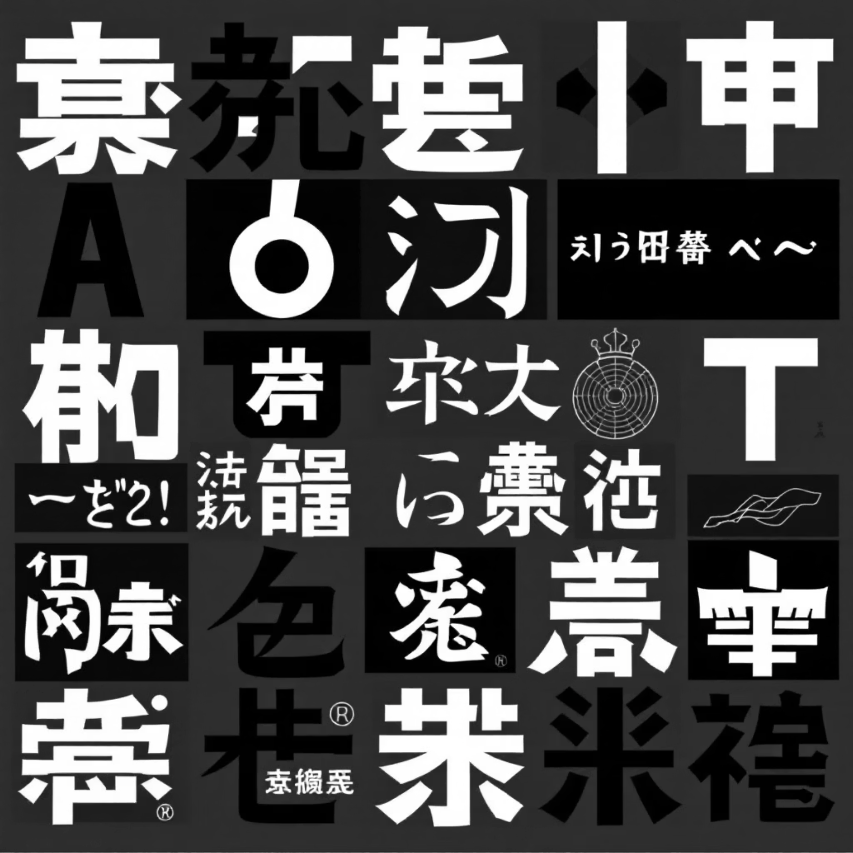
WIDGET FOCUS
1. The Text Widget
Displays a string of text with a single style.
Key Properties:
data: The string to display.
style: Controls color, font size, weight, family.
textAlign: Aligns text (center, left, right).
overflow: Handles long text (e.g., ellipsis).

Slide 4

CODE EXAMPLE
Text Widget in Action
Text( 'Hello Flutter!', style: TextStyle( fontSize: 24.0, fontWeight: FontWeight.bold, color: Colors.blue, ), textAlign: TextAlign.center, )

Slide 5
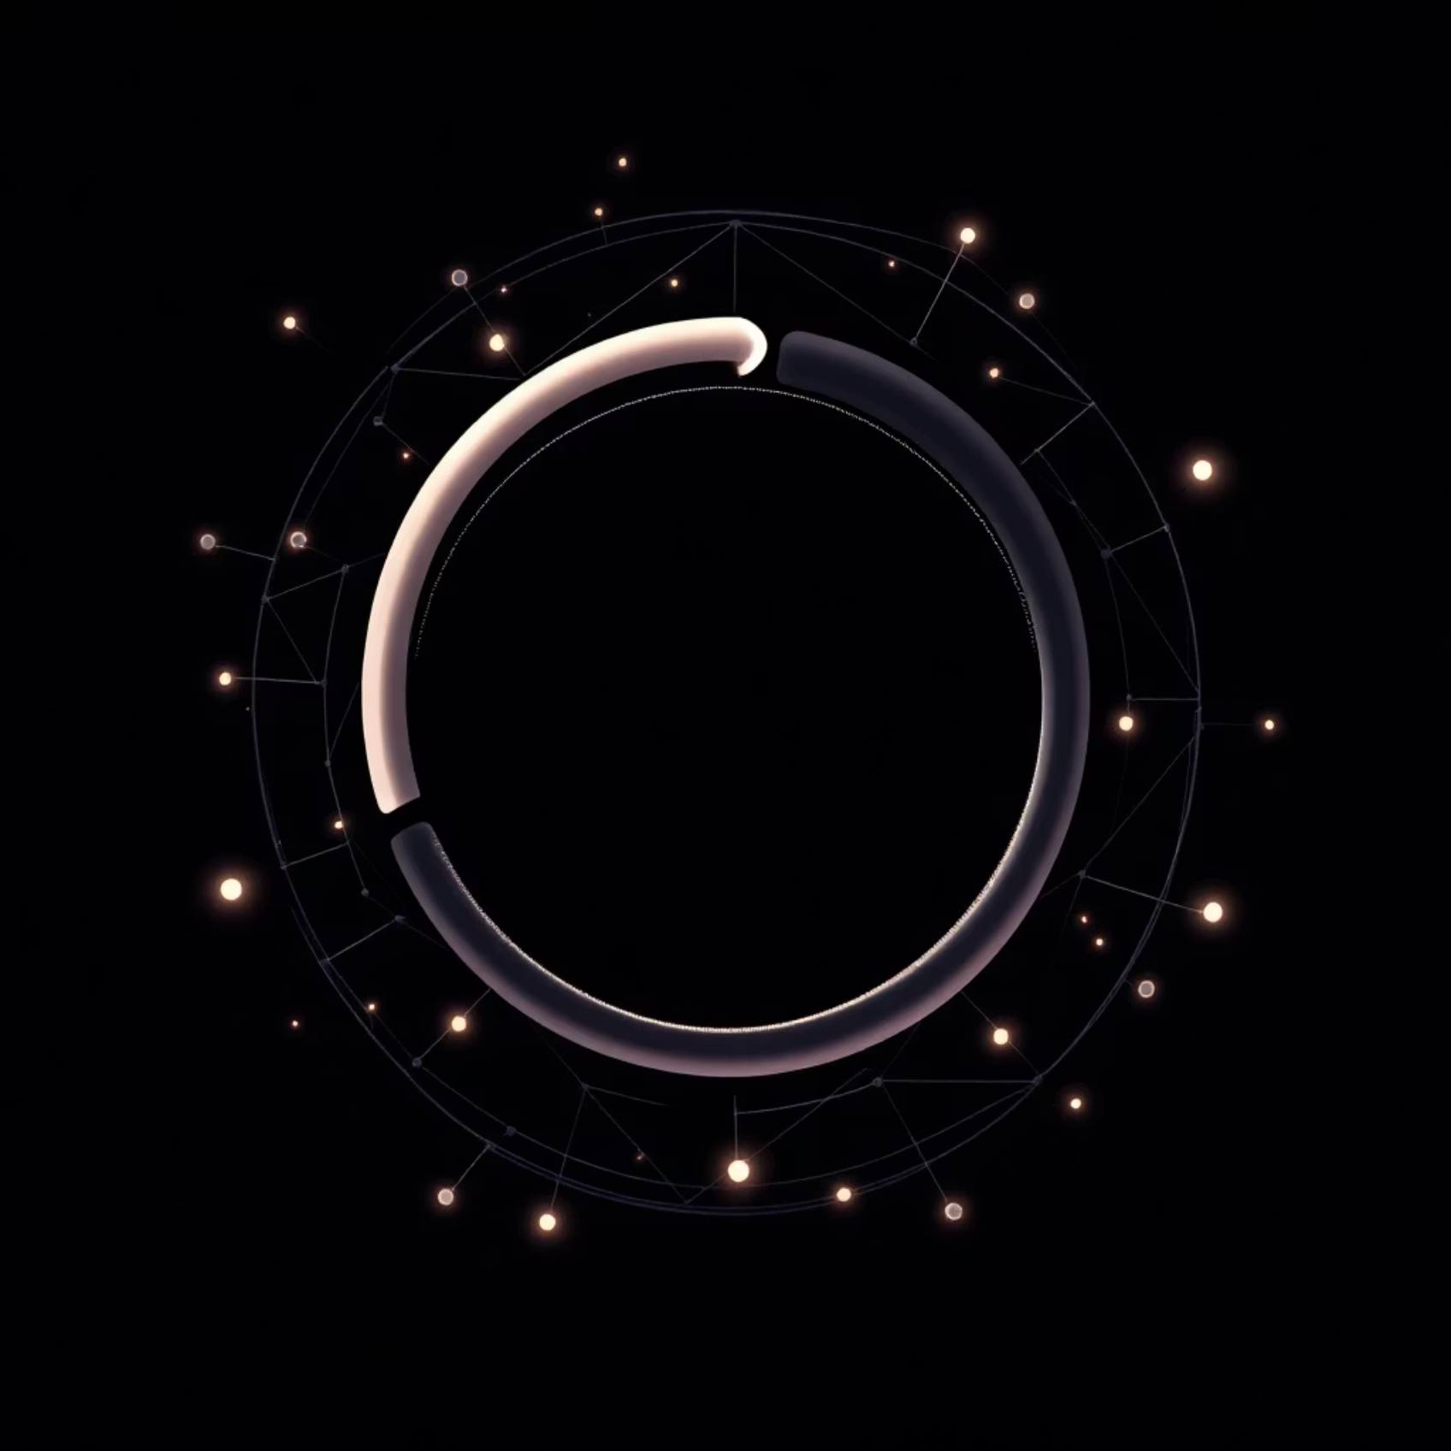
WIDGET FOCUS
2. The Image Widget
Used to display images in your application.
Two Main Types:
Image.network(): Loads from a URL.
Image.asset(): Loads from local project folder.
Properties: width, height, fit (BoxFit.cover, contain, etc.).

Slide 6
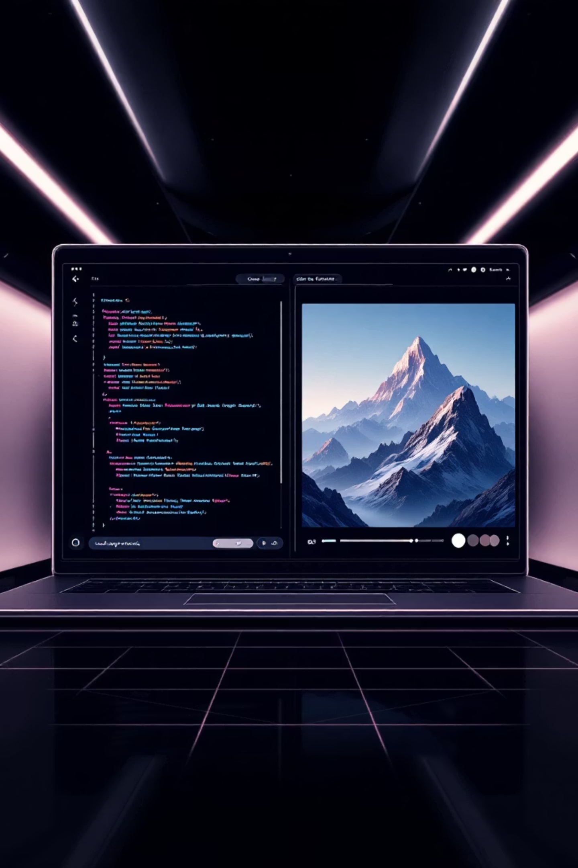
CODE EXAMPLE
Image Widget: Network Load
// Loading from the internet Image.network( 'https://example.com/logo.png', width: 100, height: 100, fit: BoxFit.cover, )

Slide 7
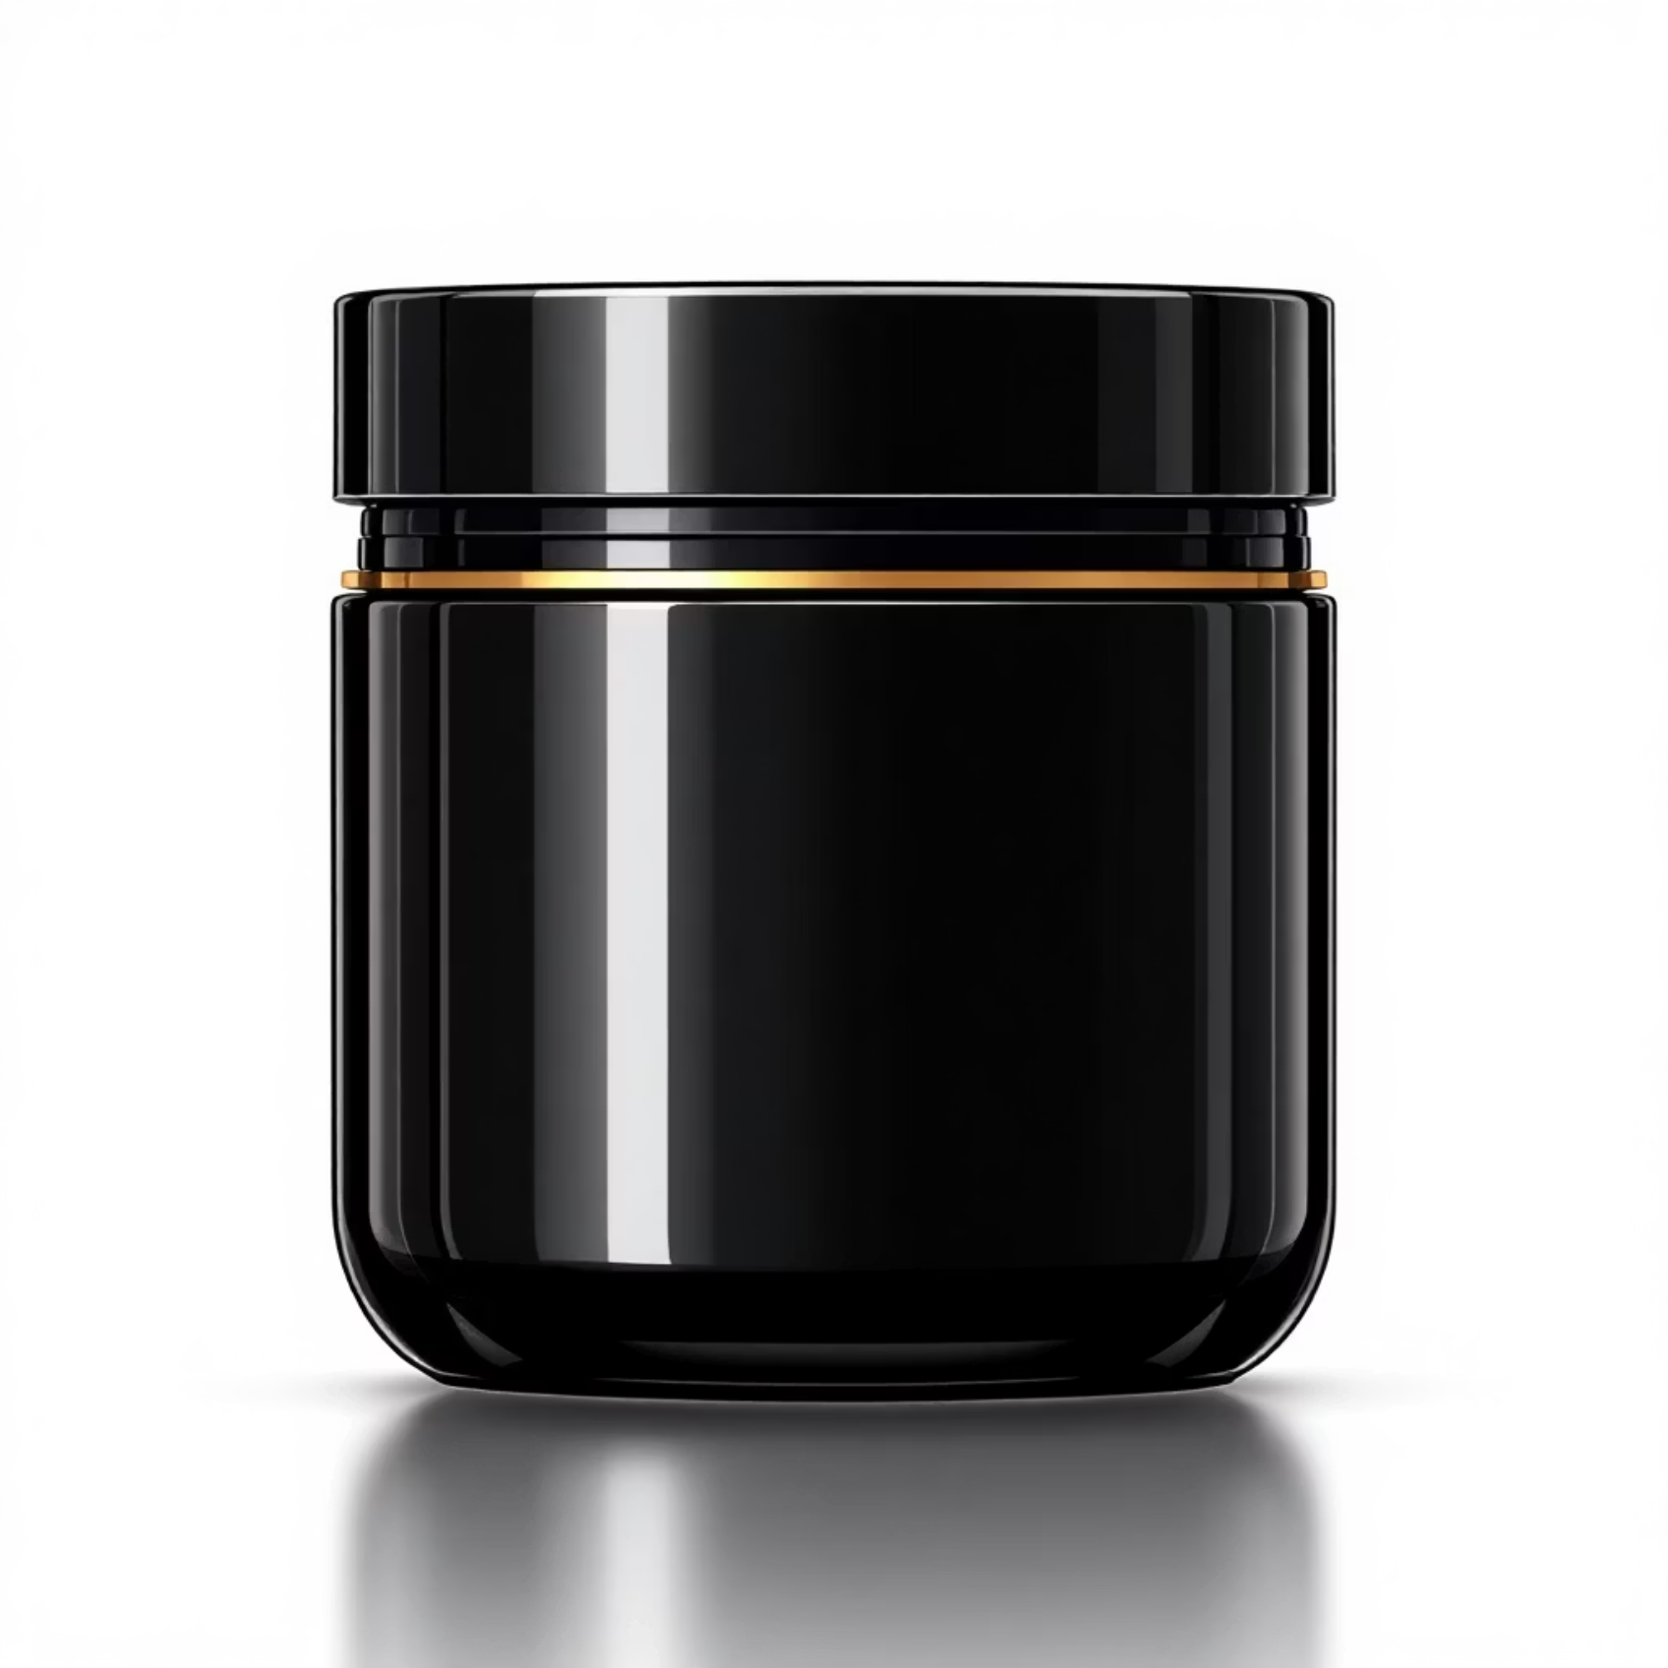

WIDGET FOCUS
3. The Container Widget
Combines painting, positioning, and sizing.
Think of it as an HTML "div".
Capabilities:
Add padding and margins.
Background colors or borders.
Transform or rotate content.
No children? Container tries to be as big as possible.

Slide 8

CODE EXAMPLE
Container Widget in Use
Container( width: 200, height: 200, padding: EdgeInsets.all(16.0), margin: EdgeInsets.symmetric(vertical: 10.0), decoration: BoxDecoration( color: Colors.amber, borderRadius: BorderRadius.circular(10), ), child: Text('Inside a Box'), )

Slide 9
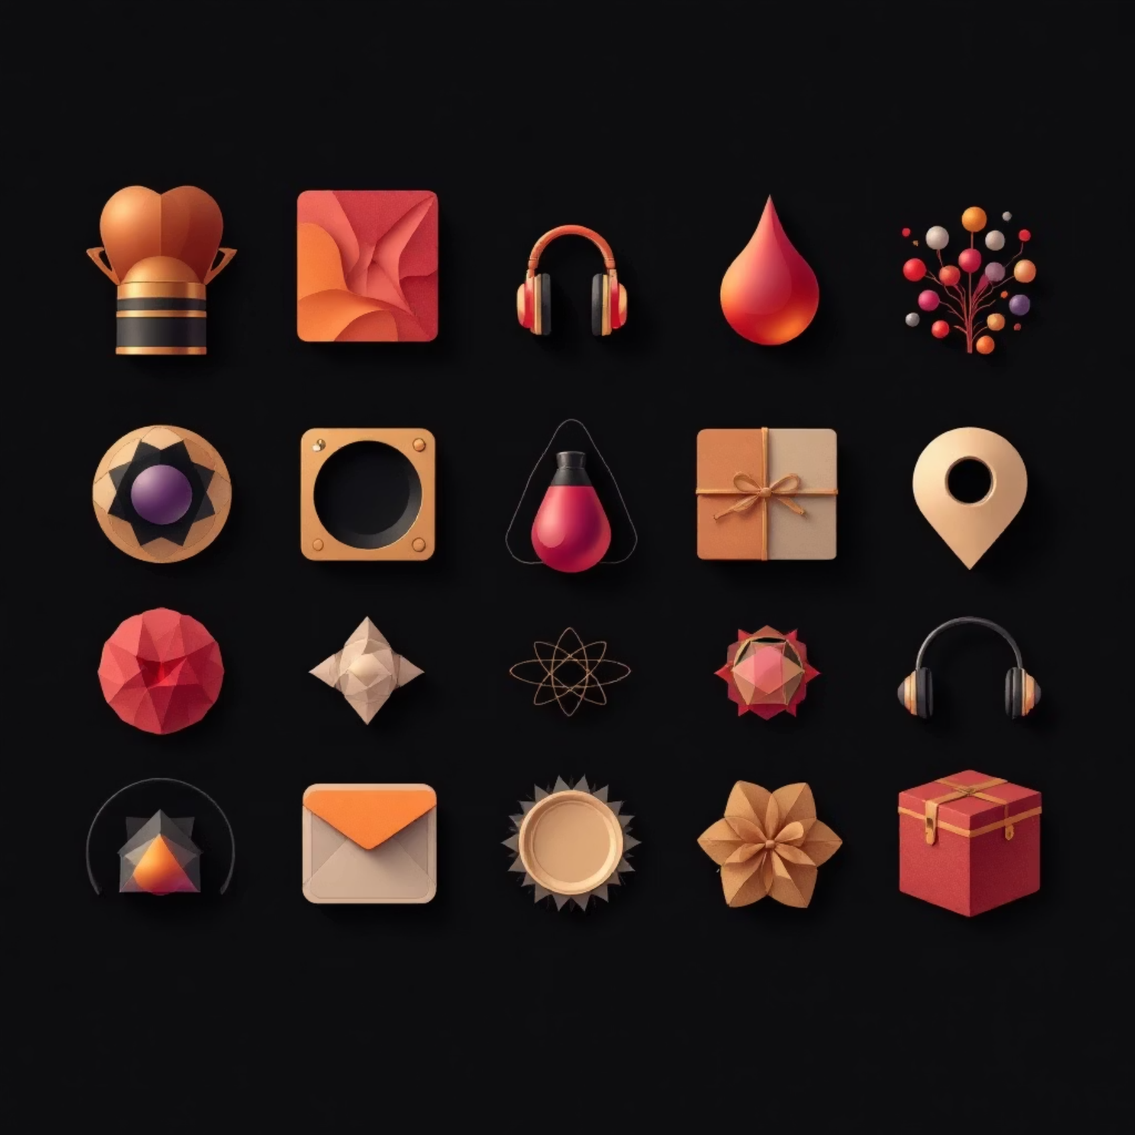
WIDGET FOCUS
4. The Icon Widget
Displays graphical icons from a font (Material Design Icons).
Non-interactive by default.
Properties:
icon: The icon data (e.g., Icons.home).
size: Size in logical pixels.
color: Color of the icon.

Slide 10
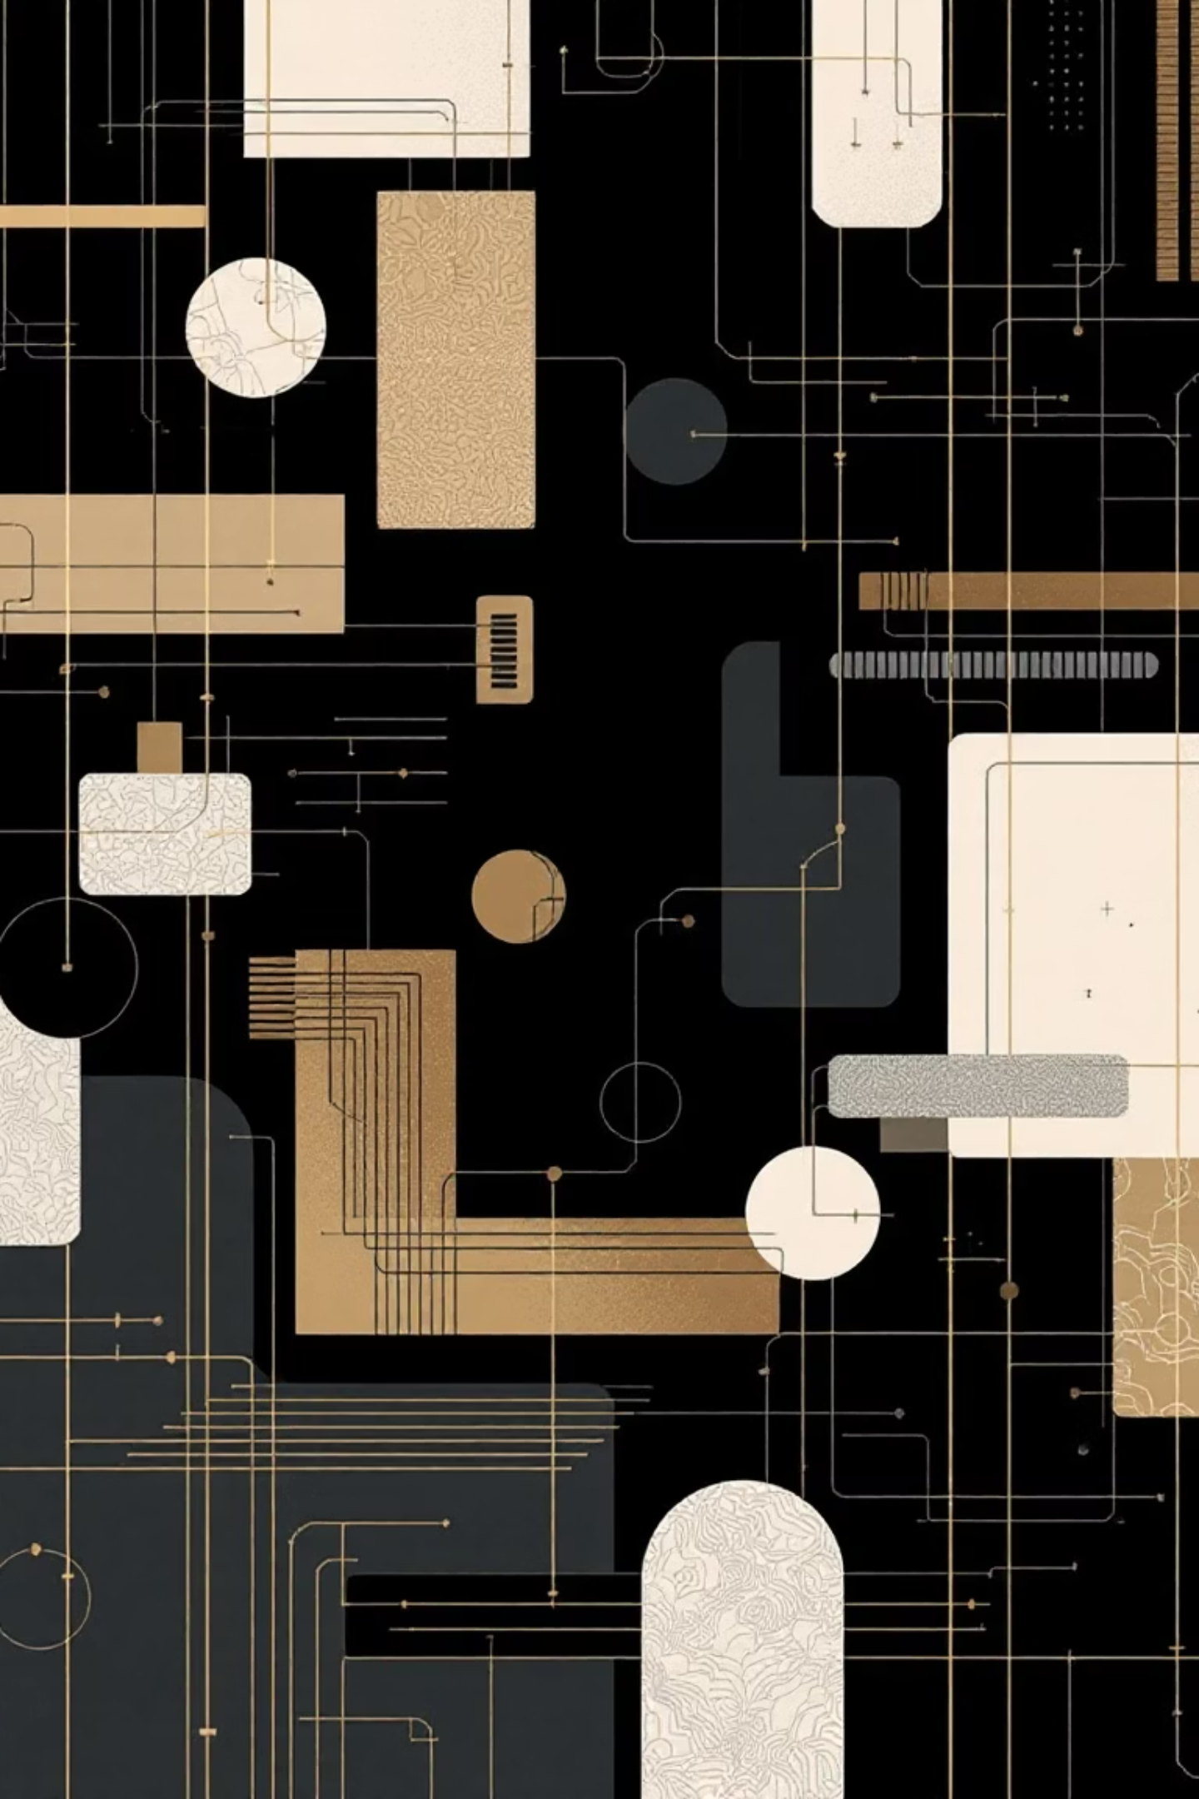

WEEK 4
Summary & Next Steps
Text
Displaying styled strings.
Image
Visual content (Network or Asset).
Container
Layout styling, padding, margins.
Icon
Standard visual symbols.
Next Week: Layouts (Row, Column, Stack)

